Slide 1



SHARED INTEREST SOCIETY – PRESENTATION NARRATED USER GUIDE
www.shared-interest.com

Slide 2
SHARED INTEREST SOCIETY
www.shared-interest.com

Slide 3

www.shared-interest.com

Slide 4
BACKGROUND
Founded in 1990 in the north-east of England
An ethical lender, which is a community-benefit society and acts co-operatively with investment from over 10,000 UK-based members and Share Capital of £52m
International organisation with teams in the UK, Kenya, Ghana, Peru and Costa Rica
Strong supporter of fair trade and a World Fair Trade Organisation (WFTO) member
Member of The Council on Smallholder Agricultural Finance (CSAF)
Recognised with a Queen’s Award in Sustainable Development three times
www.shared-interest.com

Slide 5
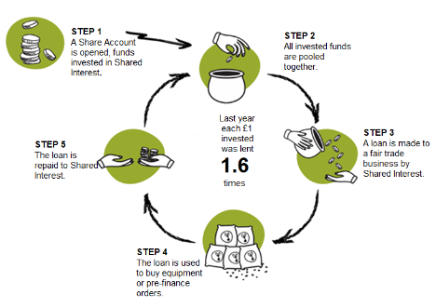
HOW IT WORKS
www.shared-interest.com
Notes:
HOW OUR LENDING WORKS
Shared Interest provides ethical finance; working in parts of the world where other lenders are less keen to operate.
We continue to focus on reaching small farming and handcraft groups in disadvantaged areas, and we know that 70% of our customers have no other source of financial support.
We balance the desire for our lending to reach those who need it most, with the need to avoid placing our members’ capital at excessive risk.

Slide 6
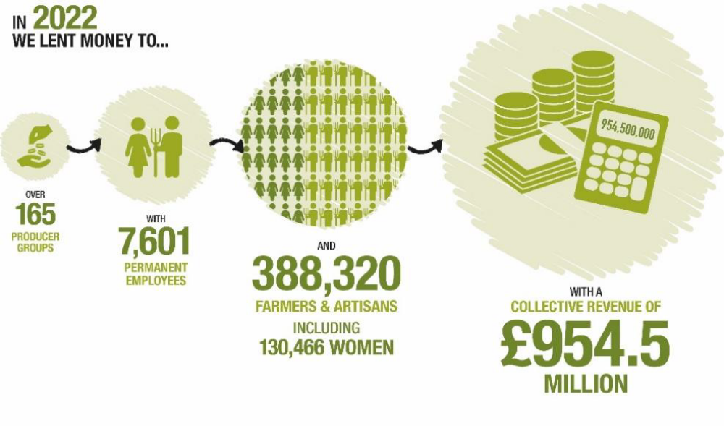
OUR IMPACT
www.shared-interest.com

Slide 7
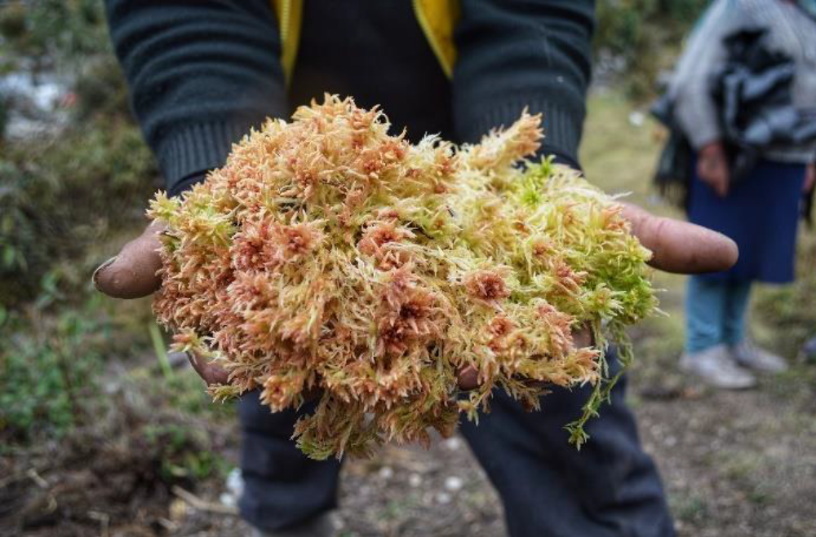
INKA MOSS
www.shared-interest.com

Slide 8
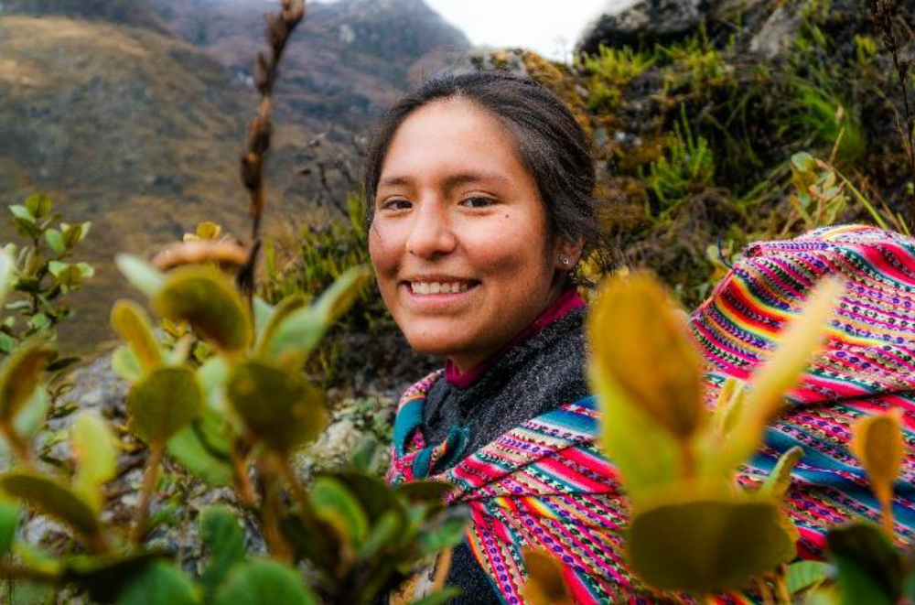
INKA MOSS
www.shared-interest.com

Slide 9
HOW IT WORKS
If you are a UK resident over the age of 16 and you want to do amazing things with your money, then a Shared Interest Share Account may appeal to you.
You can start changing lives from £100 and up to £100,000.
These vital funds are used to provide finance to fair trade farmers and craftspeople in 45 countries around the world. It is simple: your ethical investment will change lives.
The interest rate offered to members from 1st October 2021 is 0.1%.
www.shared-interest.com

Slide 10

We believe that five of the SDGs are particularly embedded in Shared Interest’s mission and values:
1. No Poverty
5. Gender Equality
8. Decent work and Economic Growth
12. Responsible Production and Consumption
17. Partnership for the Goals
www.shared-interest.com

Slide 11
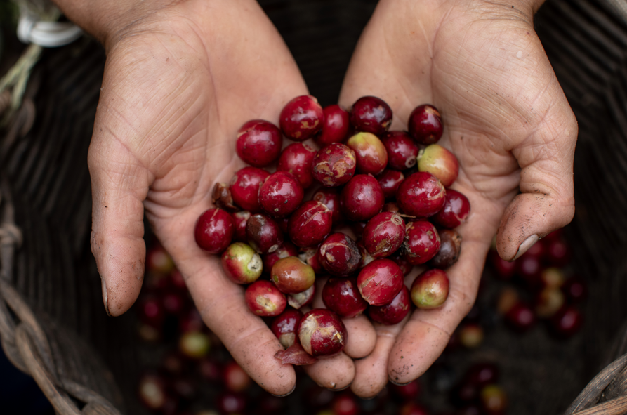
THANK YOU
www.shared-interest.com

